Slide 1
Event Echo Interim Presentation 2
Owen, Richard, Eric

Slide 2
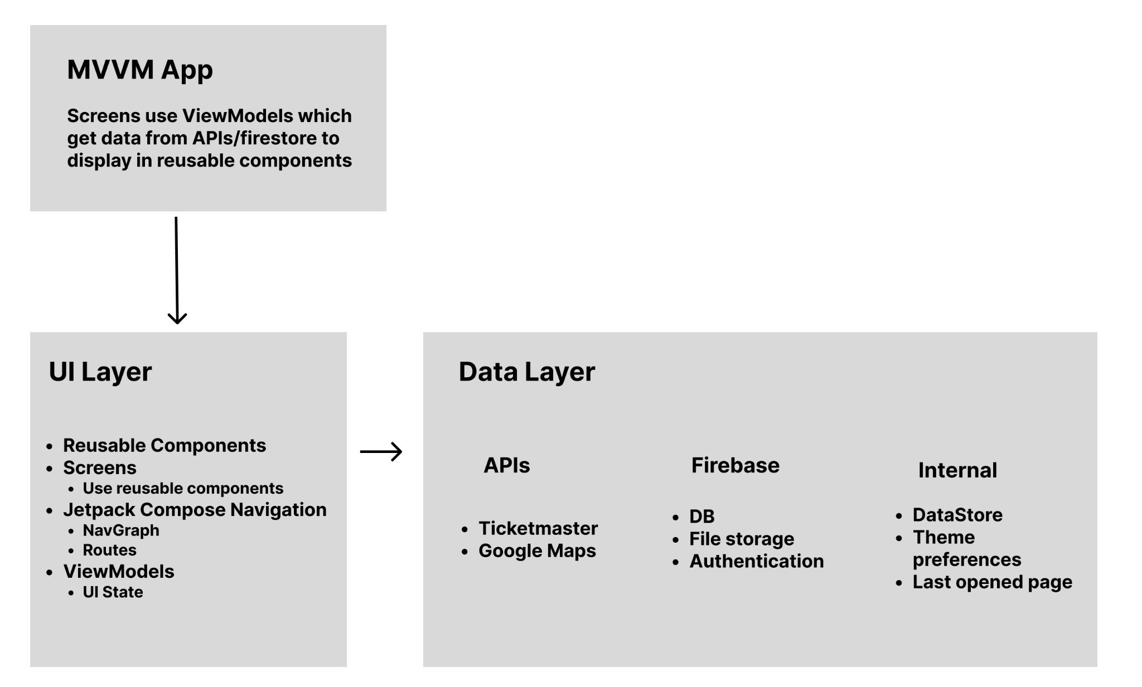
MVVM Architecture

Slide 3
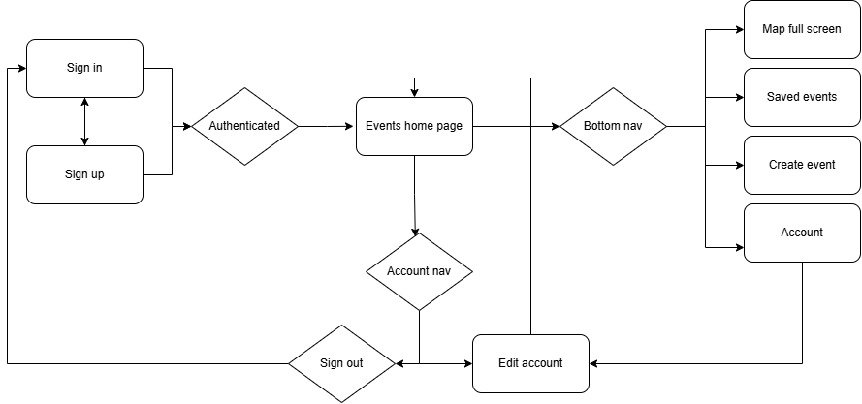
Navigation Flow

Slide 4
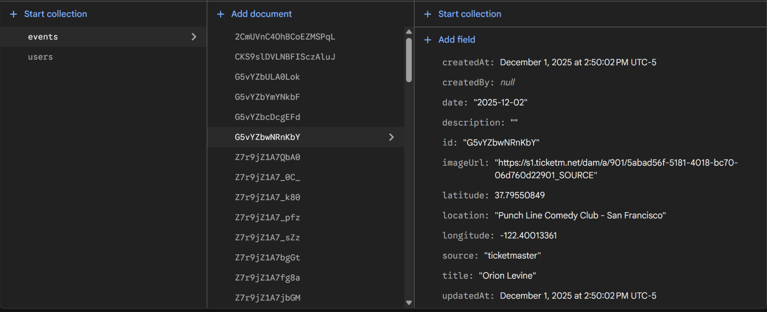
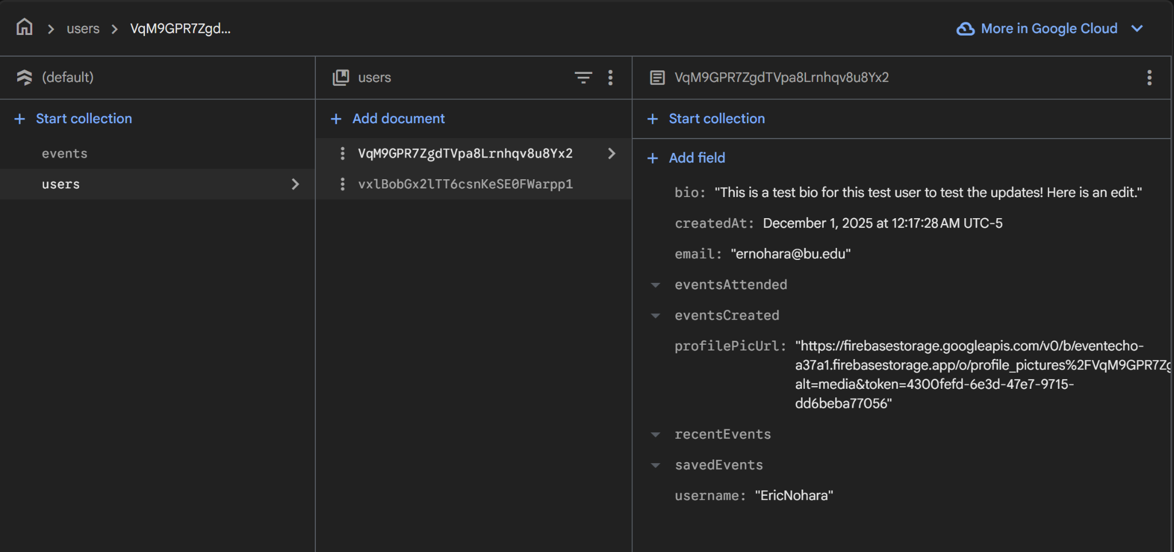
Database Schemas

Slide 5
Dependencies
Jetpack Compose
Google maps
  Play-services-maps
  Play-services-location
Firebase
  Firebase-auth
  Firebase-firestore
  Firebase-storage

Slide 6
Debugging + Testing Strategies
Utilize Logs & Logcat to write and view log/error messages
Use test data to quickly test UI changes
Test through the UI as an end user would
  Thorough testing for edge cases and unintended behavior by messing with UI
In-Progress: Automated Compose UI Testing
View data in Firebase to ensure correct values

Slide 7
Team Workflow
Feature branches merged to dev
Broke up the main features to implement
Eric
  Firebase setup and integration in app
Richard
  GPS sensor integration with Google Maps
Owen
  UI update + update to use real user/event data

Slide 8
Stretch Goals/Progress
Done
  Google maps + GPS sensor integration
  Use of third party Ticketmaster API
  Firestore integration for users and events
  File storage on Firebase
Goals:
  Complete implementation of memory wall
  Integration of camera with memory wall posting
  Polish UI
  Add onboarding when user logs in for the first time
Descoped
  AR Timeline: AR view showing memories in physical space.
  Weather Integration: Display event weather data for context.
  Social Features:
    best contributor badge,
    notifications for nearby or new events,
    Event following

